Slide 1
Game design of upper-limb rehabilitation using Haptic Robotics
By Stuart Macgregor
Notes:
Welcome to my presentation
Title is:

Slide 2
Project Aim and Motivation
To improve upper limb rehabilitation process through use of Virtual reality and haptic feedback
Contribute to the field of neurorehabilitation of the upper-limb
Increased rehabilitation demand due to improved health care and aging population
Notes:
The aim of this project is to:
- Done through use of assessment and exercise design

Slide 3
Goals of the system
Provide a safe and immersive environment
Collect quantitative kinematic data for analysis
Simple system so users can perform the tasks without special assistance
Adaptable system to serve individual requirements
Notes:
To perform upper limb exercises so users feel comfortable when performing exercises without a specialist
Analysis will involve velocity and positional data recording, with the intention of identifying weak areas patients may have upper limb impairment
Individuals may have different severity of upper limb impairment and will be at different stages of rehabilitation
The game system can be designed to be used by a range of participants suffering from different levels of motor control impairment

Slide 4
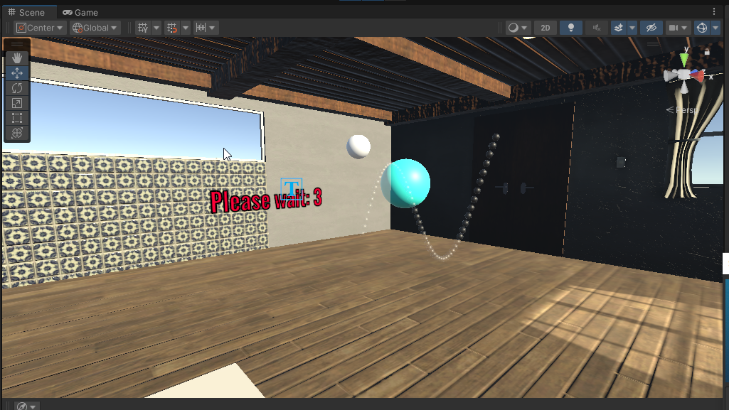
System overview – Game design
Notes:
How accurate the user is within the space rather than outside the space

Slide 5
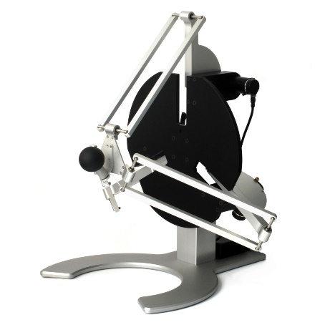
System overview – hardware setup
Force dimension delta.3 haptic device
Virtual reality headset
Notes:
Motors that apply the forces
3DOF, forces upto 20N
Button for user input
Run up to 4000Hz allowing for precise and responsive movement
Valve index
VR headset automatically integrated into unity using the streamVR plugin
Has a refresh rate of 120Hz – immersive and less chance of motion sickness as it runs smoothly

Slide 6
System overview – software setup
Target movement
Forces design
Data collection – collected at a rate of 100Hz
Notes:
Room made to give the users a familiar experience and gain orientation to reduce VR motion sickness and make them feel more comfortable
Target movement using sine wave within a clamped area
Forces design
Just say force is applied to the channel – don’t be worried if the ball goes out of range
Data collected in lists at rate of 100Hz. Records the position of the haptic device end effector

Slide 7
What the system achieves
Adaptable forces can be implemented into the designed game
Forces application can be change to suit the user's ability
The system collects positional data of the end effector and target
Positional error
Velocity
Safe and immersive environment created
Notes:
Talk about how the public variables can be changes to suit the users ability
Manage the force to the level of the user i.e more challenging or less environments

Slide 8
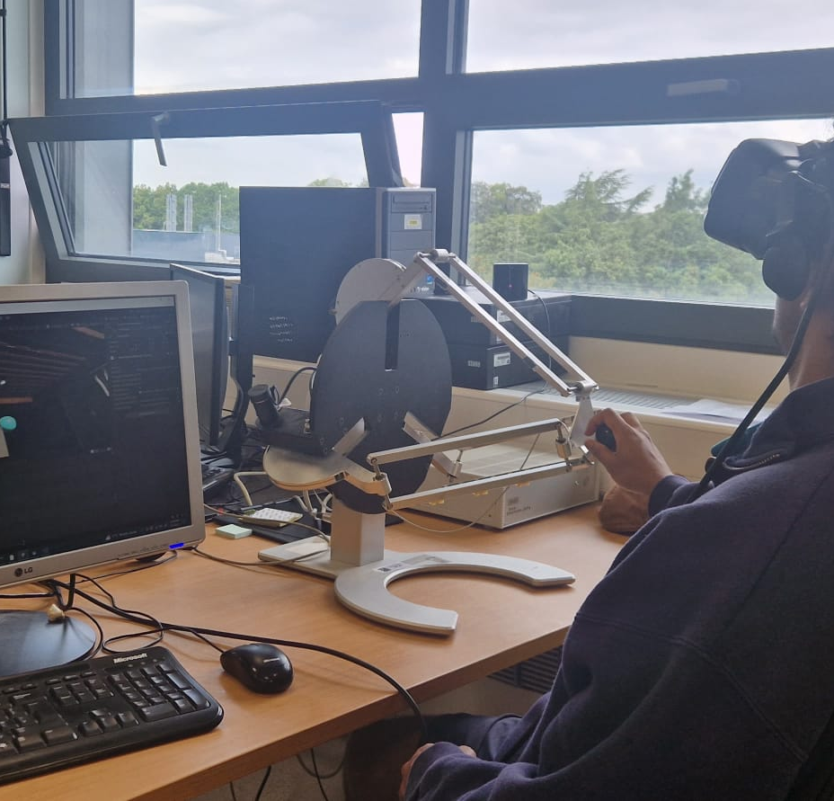
My experiment
3 phases
Baseline
Training
Testing
Repelling or no forces applied in training
Notes:
Explain the study and justify the breaks, lengths of the trials

Slide 9
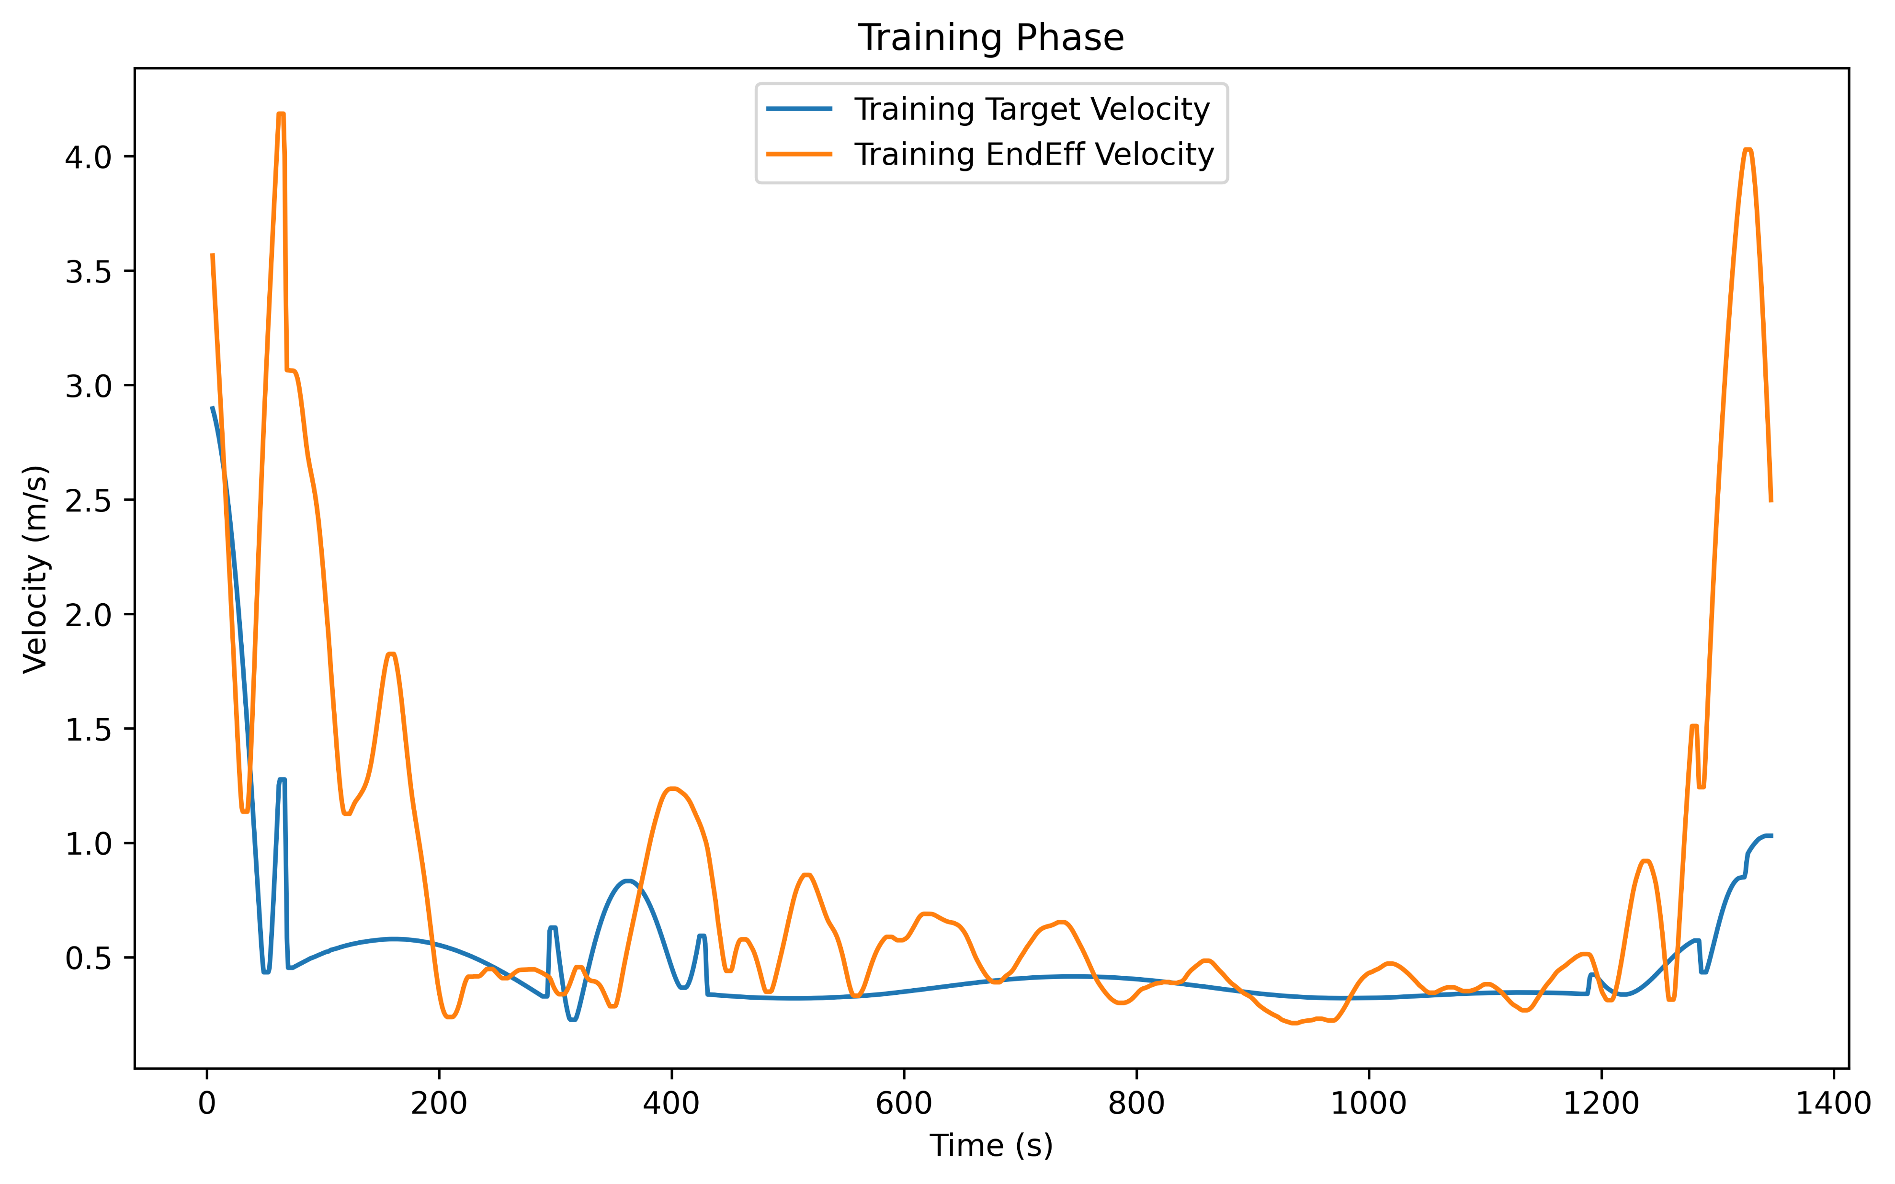
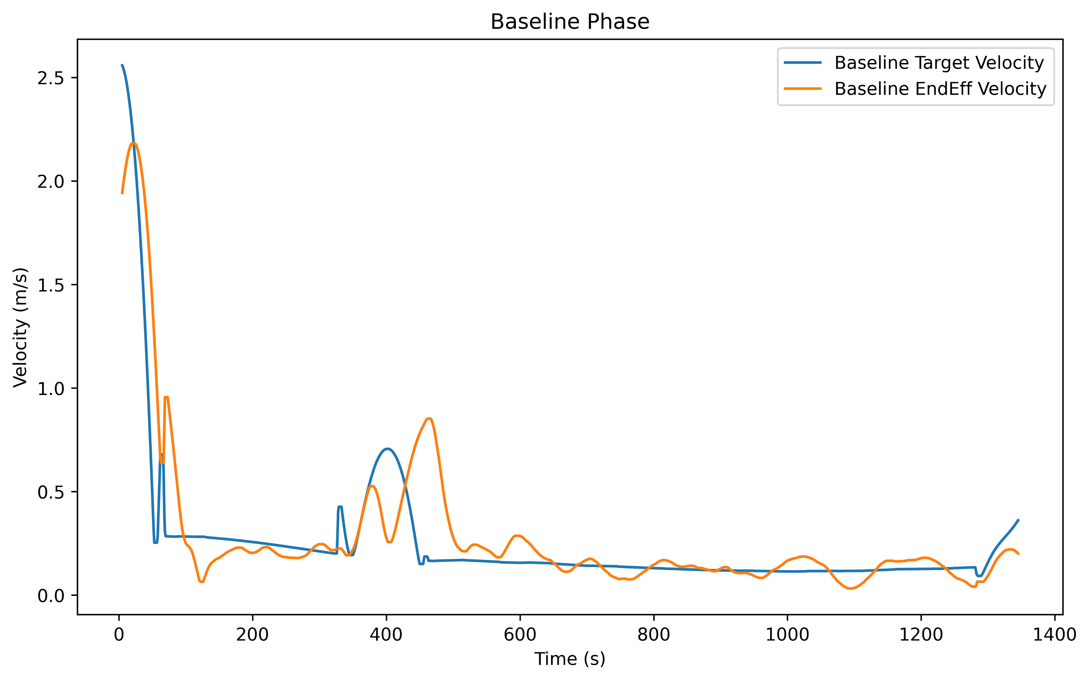
Data collection
Can calculate velocity data using positional data
Example 1
velocity of 1 study for target and end effector
1 trial, 2 different phases
Data Frame
Data Frame
Notes:
Explain the data

Slide 10
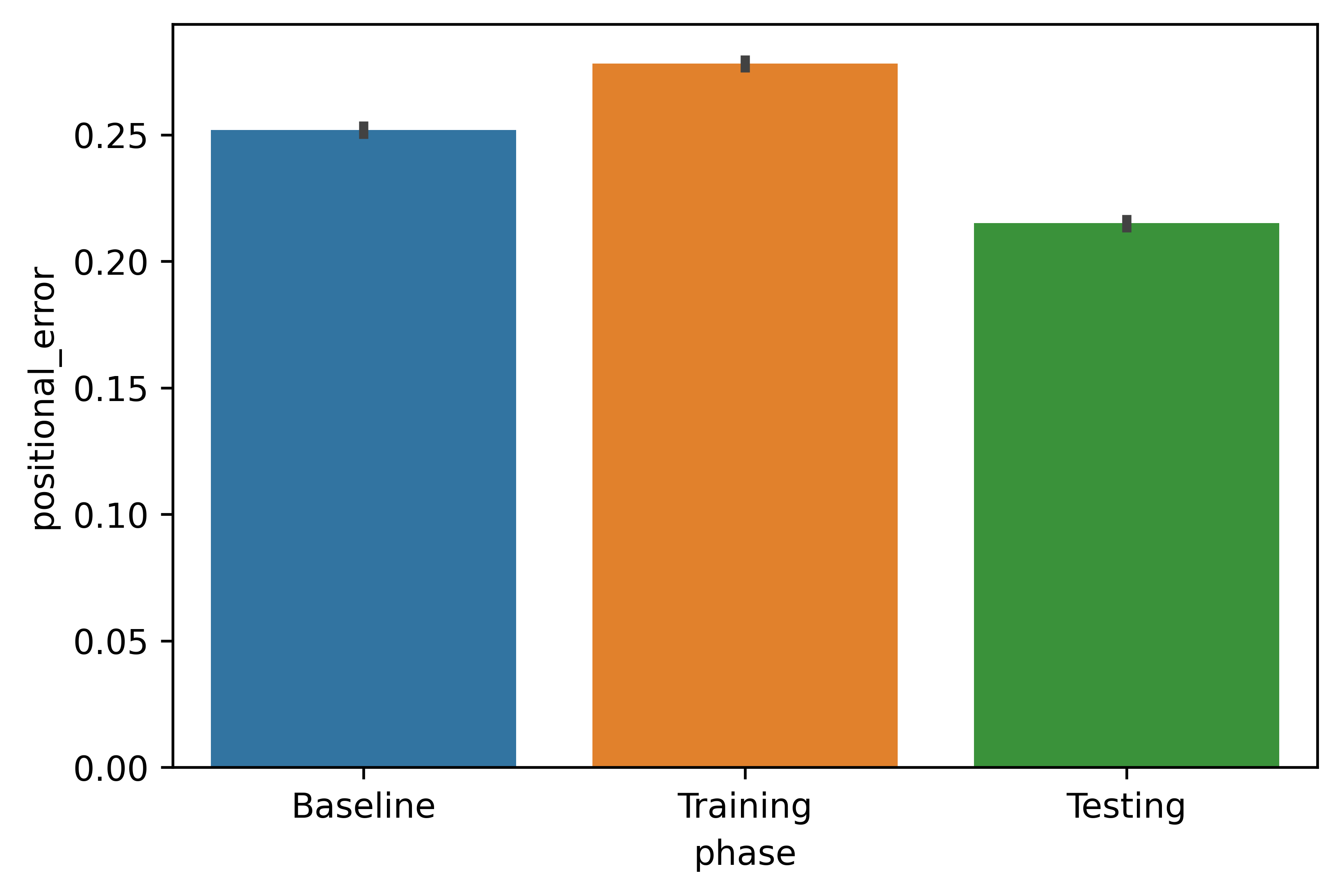
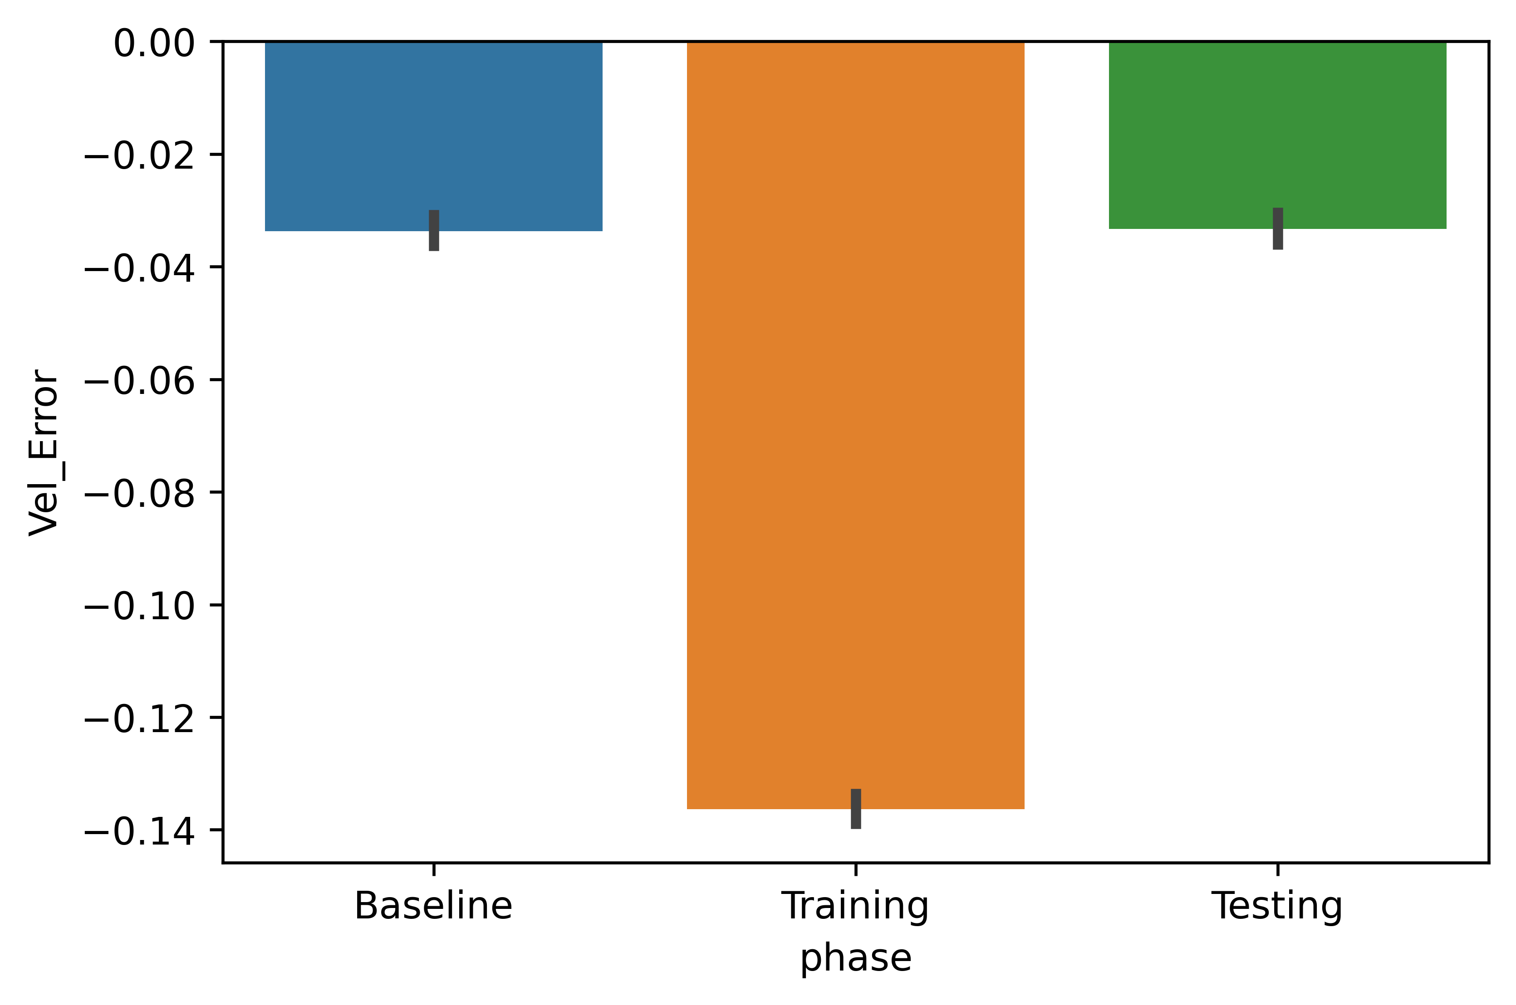
Data collection continued
Example 2
Data collected across 5 studies
Positional error average
Velocity error average
Notes:
Explain the data

Slide 11
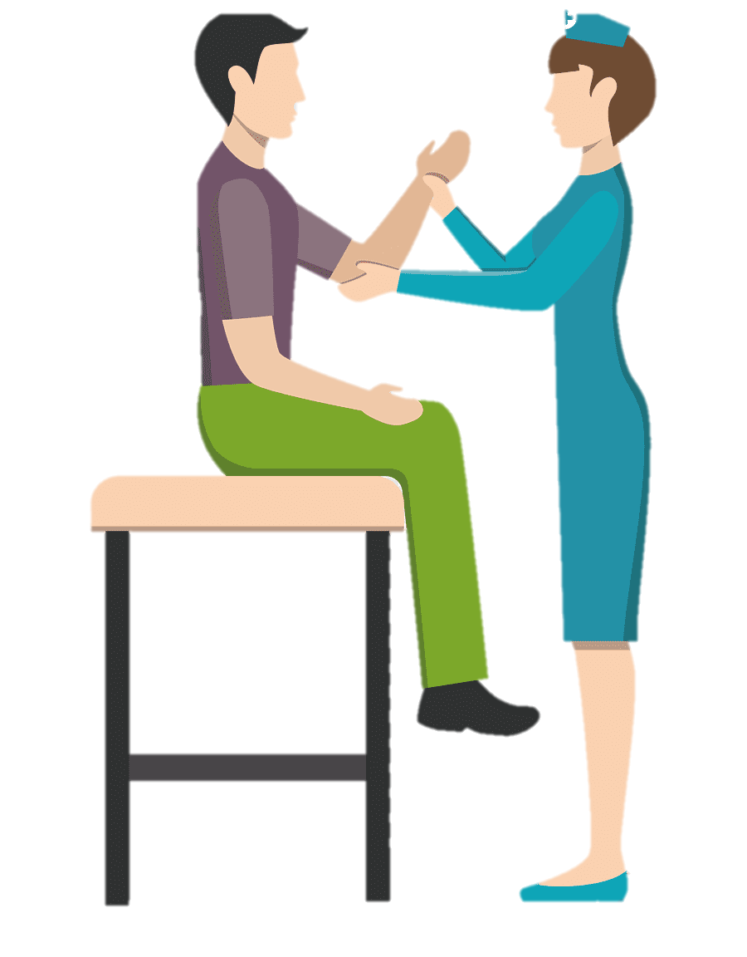
Real world relevance
Data collected can be used by rehabilitation specialists to identify weaknesses in individual movement and adapt the patient's rehabilitation program accordingly
Expected outcome of individuals with upper-limb impairment
Decrease in positional and velocity error i.e more accurate

Slide 12
Evaluation
Tested on 18 healthy participants and requested feedback
Data collection shows interpretable results showing the designed system works

Slide 13

Thank you for your time!
Demonstration
Any questions?

